Slide 1
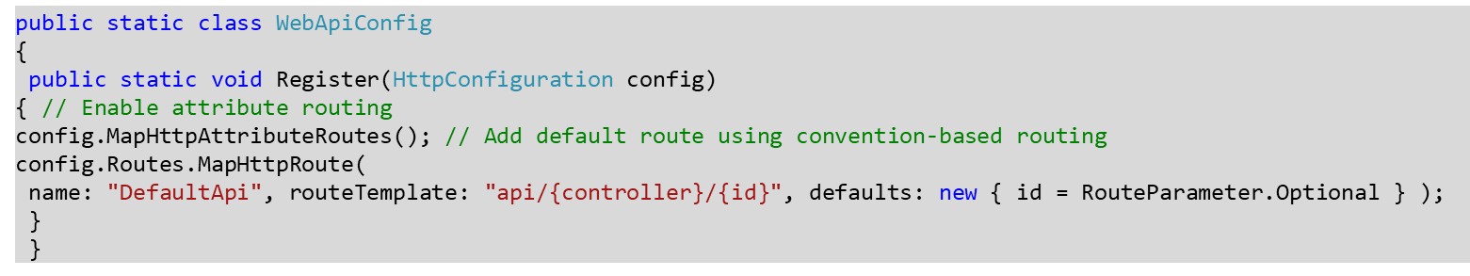
WebAPI Routing
Web API routing is similar to ASP.NET MVC Routing. It routes an incoming HTTP request to a particular action method on a Web API controller.
Web API supports two types of routing:
Convention-based Routing
Attribute Routing
Convention-based Routing
In the convention-based routing, Web API uses route templates to determine which controller and action method to execute. At least one route template must be added into route table in order to handle various HTTP requests.
Default Routing

Slide 2
In the above WebApiConfig.Register() method, config.MapHttpAttributeRoutes() enables attribute routing
The config.Routes is a route table or route collection of type HttpRouteCollection. The "DefaultApi" route is added in the route table using MapHttpRoute() extension method. The MapHttpRoute() extension method internally creates a new instance of IHttpRoute and adds it to an HttpRouteCollection.
The following is a sample HTTP GET request.
The above request will execute Get() action method of the ValuesController because HTTP method is a GET and URL is http://localhost:1234/api/values which matches with DefaultApi's route template /api/{controller}/{id} where value of {controller} will be ValuesController.
Default route has specified id as an optional parameter so if an id is not present in the url then {id} will be ignored. The request's HTTP method is GET so it will execute Get() action method of ValueController.
Sample HTTP GET Request
GET http://localhost:1234/api/values/ HTTP/1.1
User-Agent: Fiddler
Host: localhost: 60464
Content-Type: application/json

Slide 3
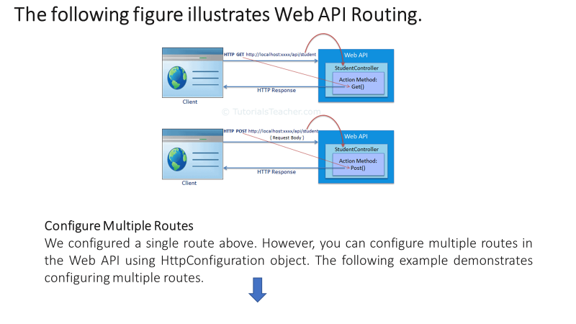

Slide 4
public static class WebApiConfig { public static void Register(HttpConfiguration config) { config.MapHttpAttributeRoutes(); // school route config.Routes.MapHttpRoute( name: "School", routeTemplate: "api/myschool/{id}", defaults: new { controller="school", id = RouteParameter.Optional } constraints: new { id ="/d+" } ); // default route config.Routes.MapHttpRoute( name: "DefaultApi", routeTemplate: "api/{controller}/{id}", defaults: new { id = RouteParameter.Optional } ); } }
In the above example, School route is configured before DefaultApi route. So any incoming request will be matched with the School route first and if incoming request url does not match with it then only it will be matched with DefaultApi route. For example, request url is http://localhost:1234/api/myschool is matched with School route template, so it will be handled by SchoolController.

Slide 5
Attribute Routing
Attribute routing is supported in Web API 2. As the name implies, attribute routing uses [Route()] attribute to define routes. The Route attribute can be applied on any controller or action method.
In order to use attribute routing with Web API, it must be enabled in WebApiConfig bycalling config.MapHttpAttributeRoutes() method.
public class StudentController : ApiController
{
[Route("api/student/names")]
publicIEnumerable<string> Get()
{ return new string[]
{ "student1", "student2" }; } }
In the above example, the Route attribute defines new route "api/student/names" whichwill be handled by the Get() action method of StudentController. Thus, an HTTP GET request http://localhost:1234/api/student/names will return list of student names

Slide 6

Thank You

